Slide 1


Dimitrios Valsamaras Senior Security Researcher Microsoft Threat Intelligence
Android Universal Overlays

Slide 2




about://me
@Ch0pin​
/Ch0pin
Engaged in computer security since 2002
@ch0pin@infosec.exchange
Focus on Android Security for the last 5 years
Previously leading a malware research team
Senior Security Researcher @Microsoft
Father of two​
Musician, guitarist, pianist

Slide 3

Did you say Android ?

Slide 4


Outline
The Android User Interface
GUI Confusion Attacks, the story so far
A behavior so far unnoticed
Universal Overlays
Defense and takeaways

Slide 5
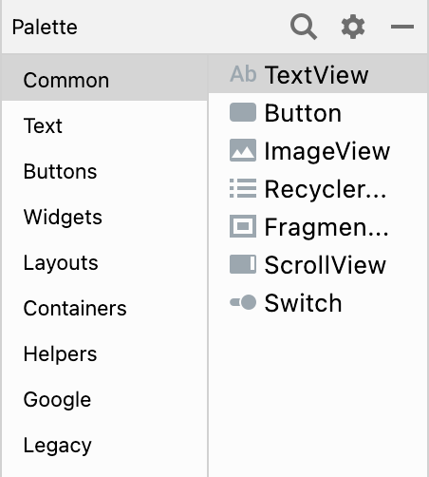

The Android User Interface
Application
Application
Application
window
Surface
Surface
Surface
SurfaceFlinger
Hardware Composer
Display

Slide 6
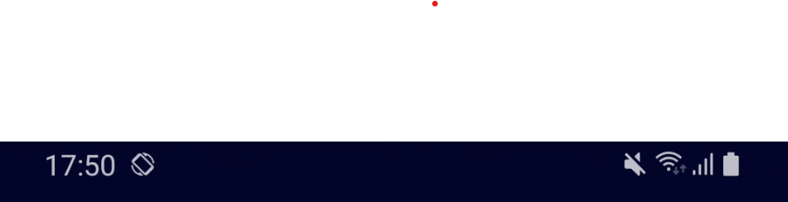
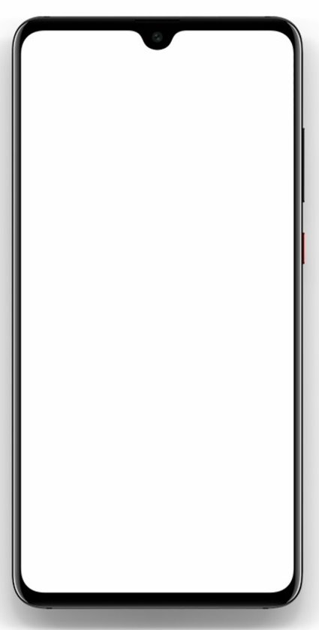
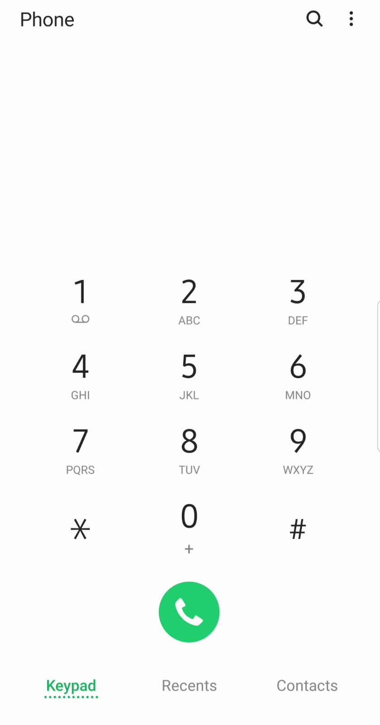
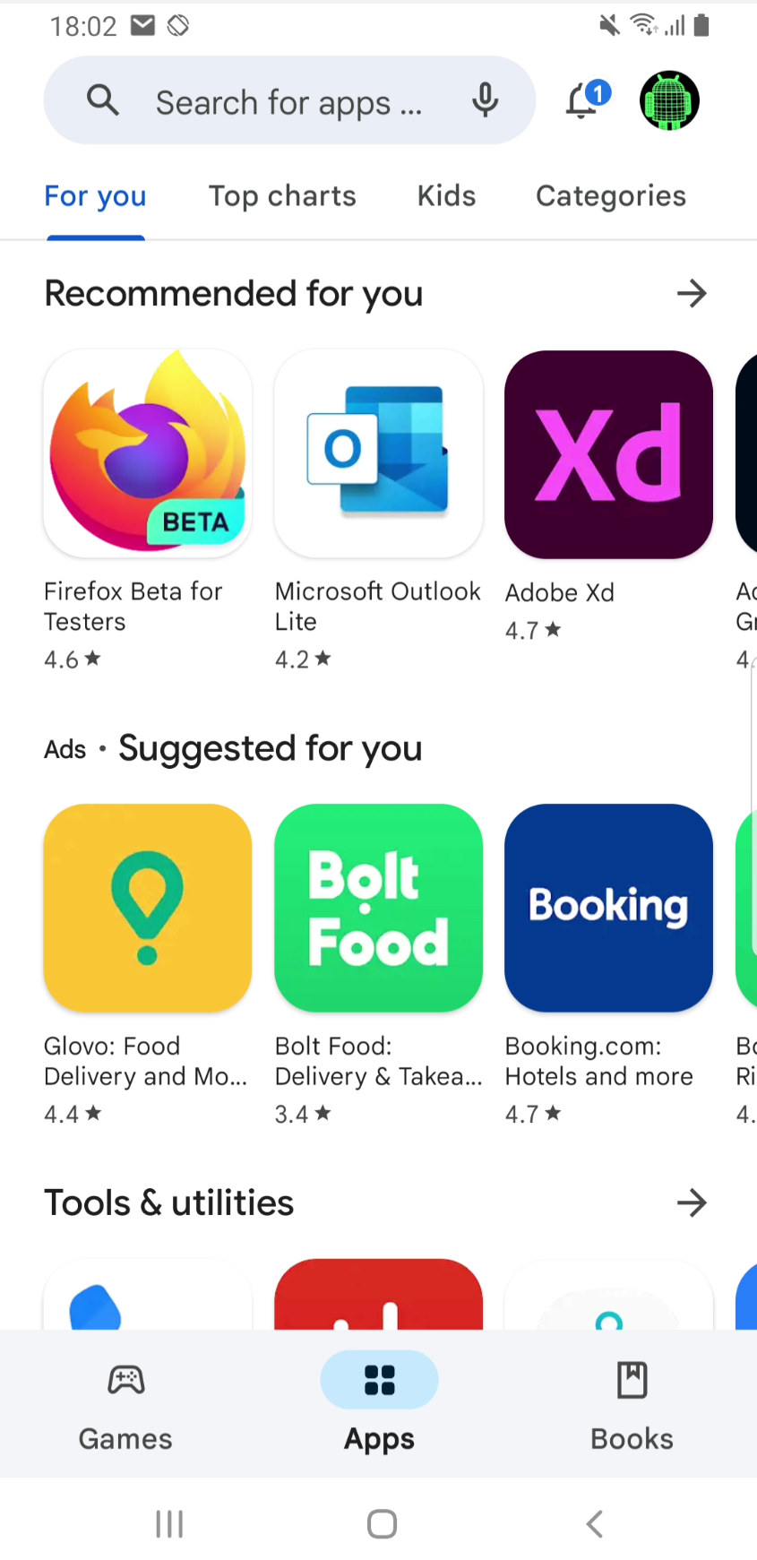

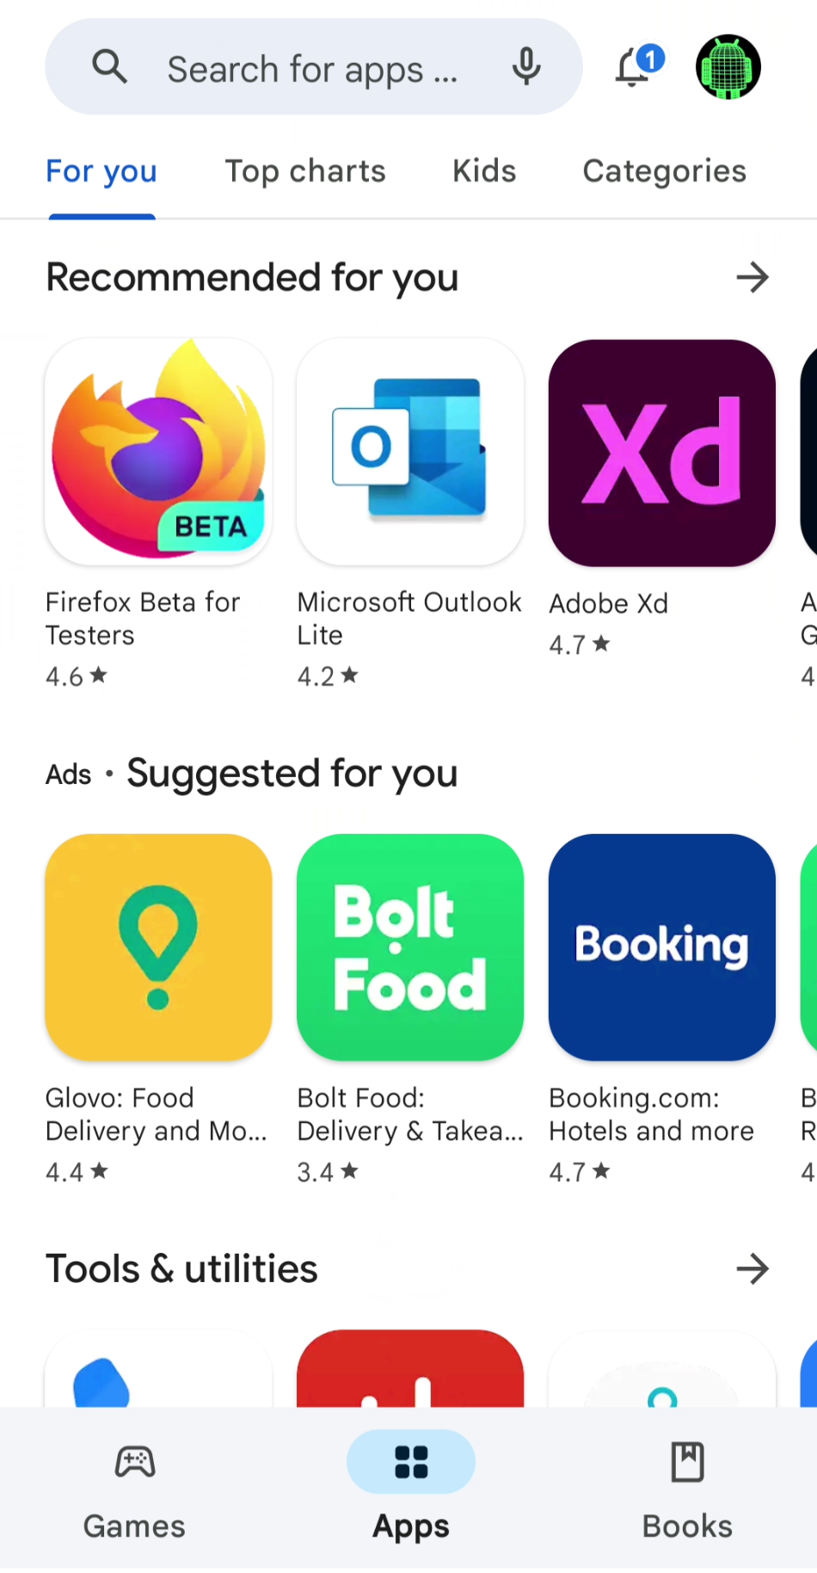
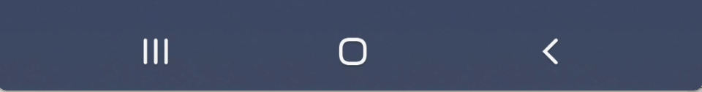
The Android User Interface
WindowManager
SurfaceFlinger

Slide 7
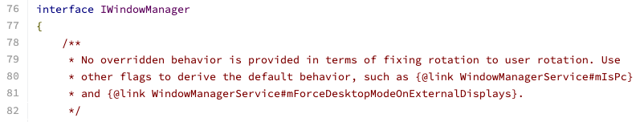
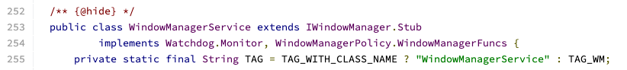
The Window Manager
3rd party apps don't have access to the raw AIDL
But they can access certain properties via other classes
(e.g., Window or WindowManager, ViewConfiguration)

Slide 8
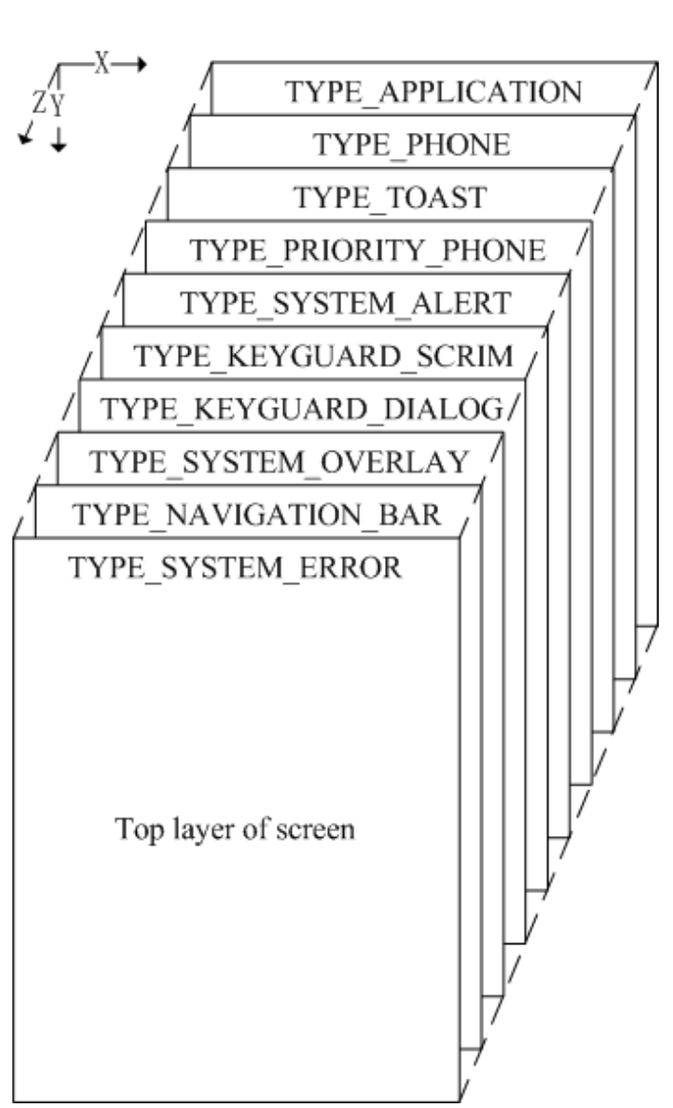
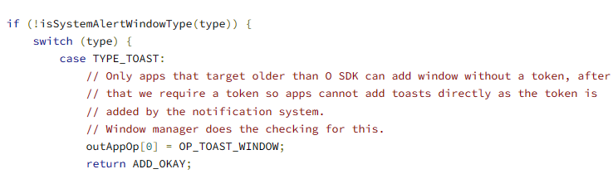
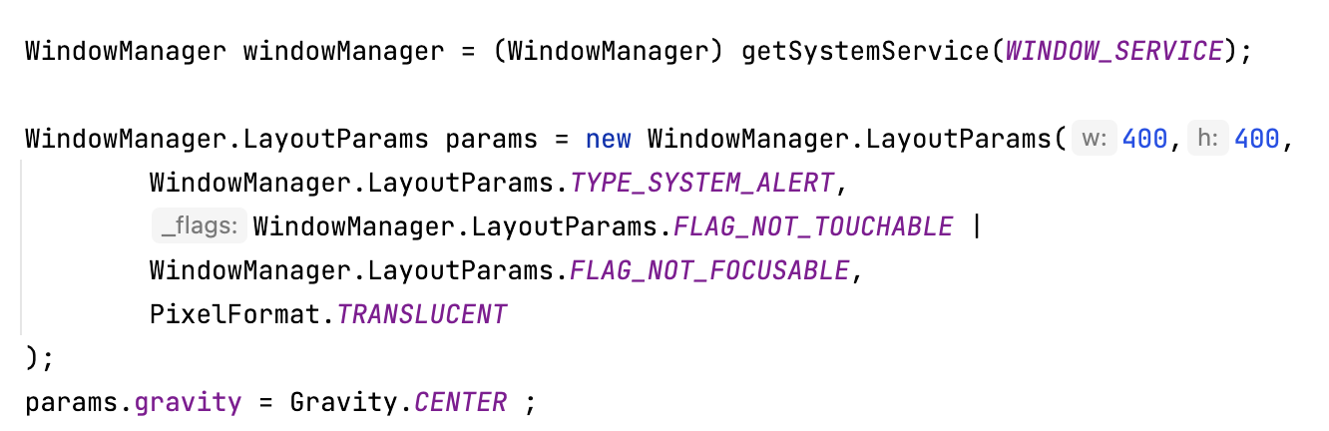
The Z-Order
frameworks/base/+/master/services/core/java/com/android/server/policy/PhoneWindowManager.java
Window types and priorities up to Android O
Source : Ying Et al. Attacks and defense on Android Free Floating Windows
SYSTEM_ALERT_WINDOW

Slide 9
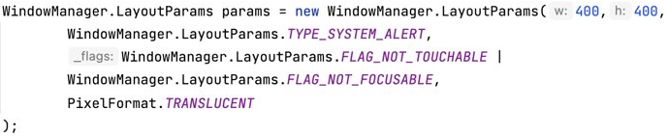


The window behavior

Slide 10
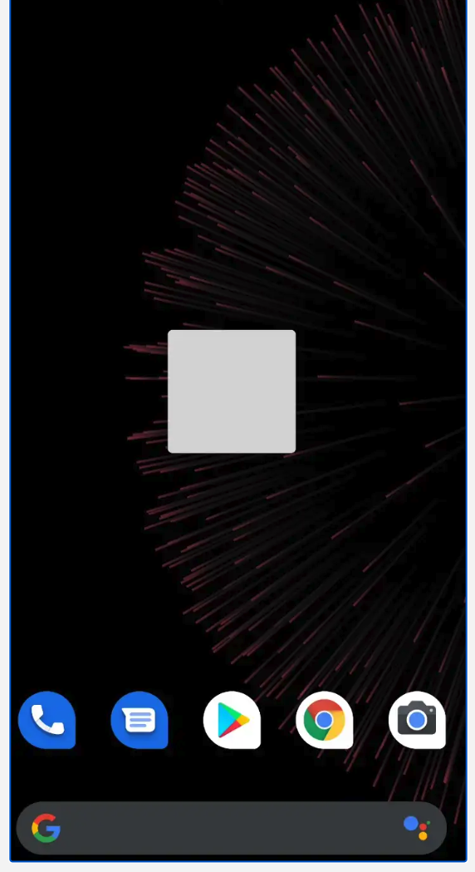
The Window Manager
Floating window

Slide 11
The Android User Interface
Android is an operating system that more
than one application can run concurrently in the background
Each time only one application interacts with the users
A digital signature can assure that an APK
originates from the same developer
Installing software from trusted sources like the
Google PlayStore assure that an application
meets some certain criteria

Slide 12
The Android User Interface
Problem Statement:
Whom am I talking to ?
There is no explicit information showing to users about the active user interface and the application it belongs to (Ying Et al.)
And so, any application can imitate the user interface of another application and claim legitimacy

Slide 13
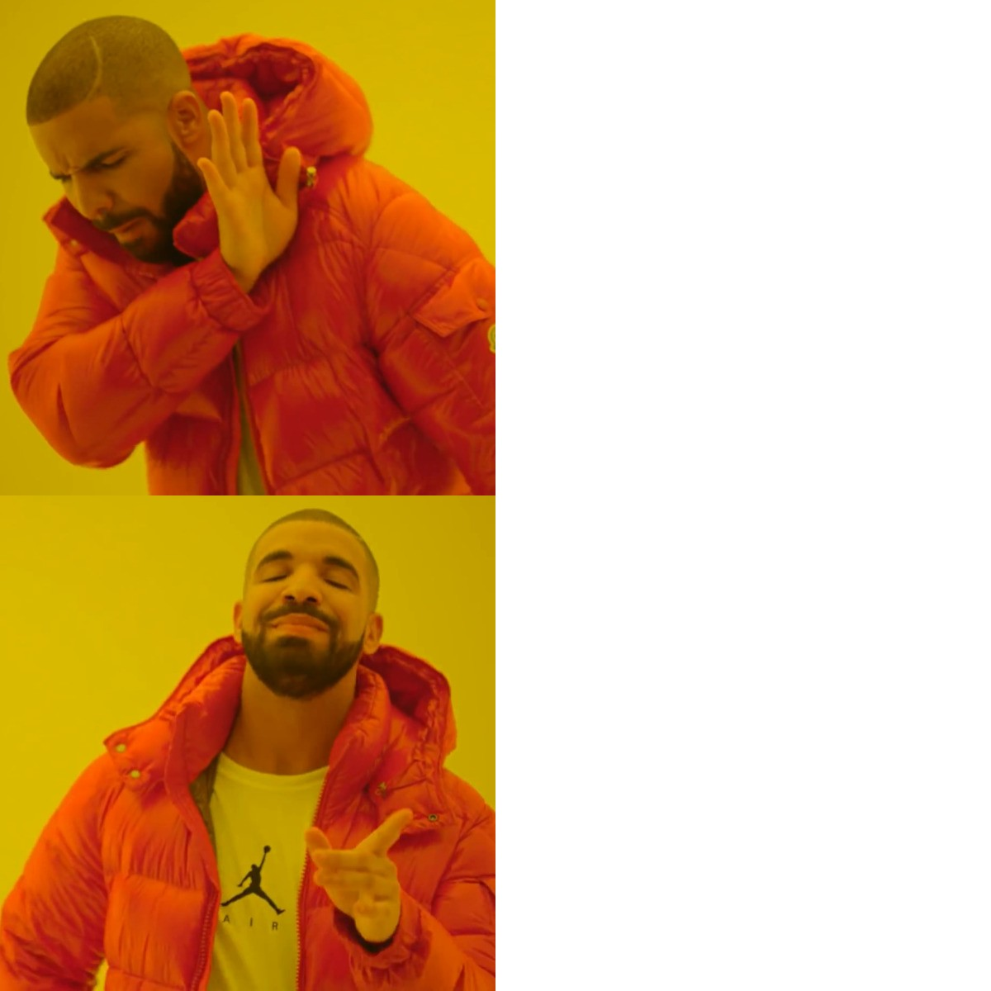
GUI Confusion Attacks
Tap Jaking over an unprotected view with actual exploitation by bank phishing bots, affecting billions of users.
Use after free with theoretical or no actual exploitation, affecting ACME's device.

Slide 14

GUI Confusion Attacks
Using overlay
Task Hijacking
Activity Switching

Slide 15
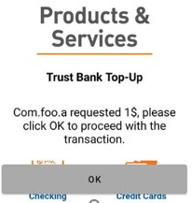
Overlays
Conceal a part or all of a message communicated through a GUI with the aim of tricking the user into carrying out an action that wouldn't normally perform.

Slide 16
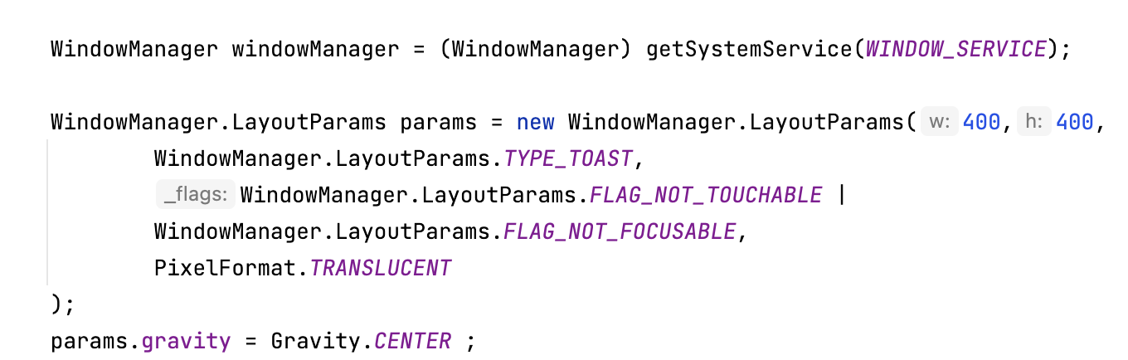
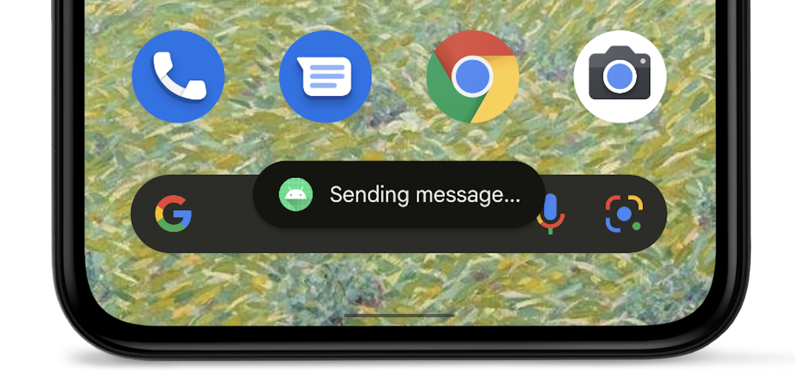
Overlays
TYPE_TOAST
(Toast overlay attack)

Slide 17
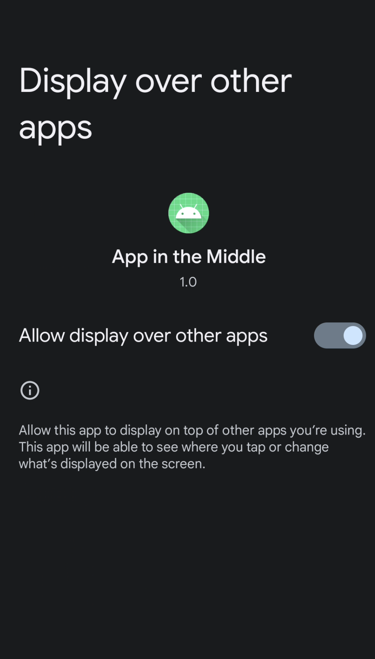
Overlays
TYPE_SYSTEM_ALERT
TYPE_APPLICATION_OVERLAY
SYSTEM_ALERT_WINDOW

Slide 18
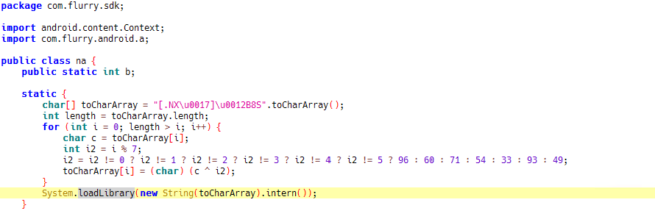
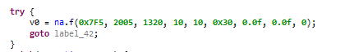
Overlays
FLURRY99 (ADWARE)
CVE-2020-0099
TYPE_TOAST
TYPE_PRESENTATION

Slide 19
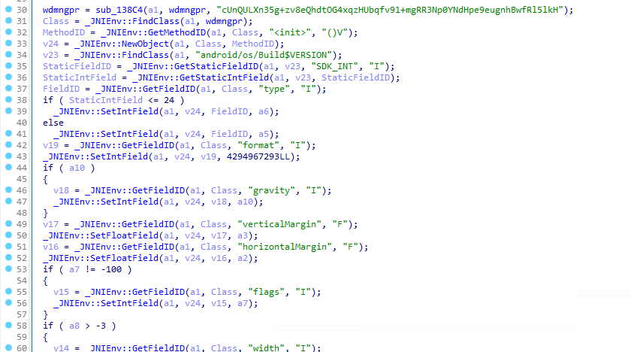
Overlays
TYPE_TOAST
TYPE_PRESENTATION
CVE-2020-0099

Slide 20
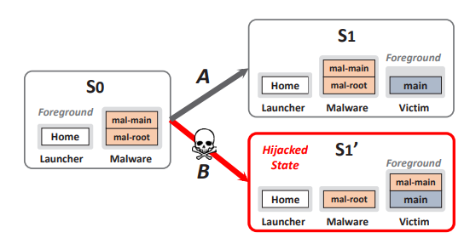
Task Hijacking
Abuse task state transition conditions, i.e. taskAfinity and allowTaskReparenting to hijack a victim app's UI (StrandHogg attack).
Hijacked task state
Source : Chuangang Et al. Towards Discovering and Understanding Task Hijack in Android

Slide 21

Task Hijacking (example)
Victim: com.secure.app
A1.taskAfinity: com.secure.app
A1.allowTaskReparenting: true

Slide 22


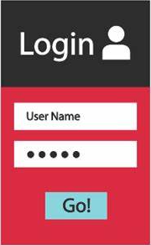
Activity switching
Abusing APIs used to bring an activity to the top of the screen (startActivity, moveTaskTo etc.)
Foreground
com.example.app
com.ackme.bank
com.foo.bar
startActivity(evilIntent)

Slide 23
Activity Switching (restrictions)
(A) No visibility on which app is on top
(B) Can't start an activity from the background
Exceptions:
Accessibility service (A, B)
Usage Stats (A)
SAW (B)
Full Screen Intents (B)

Slide 24
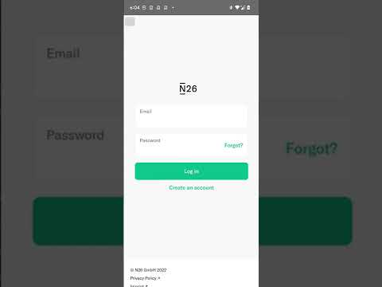

Slide 25
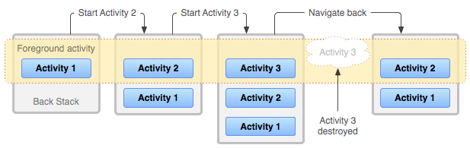
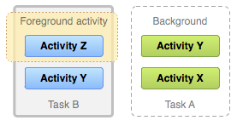
A behavior so far unnoticed
Retains the current state of its user interface
Back stack remains intact

Slide 26
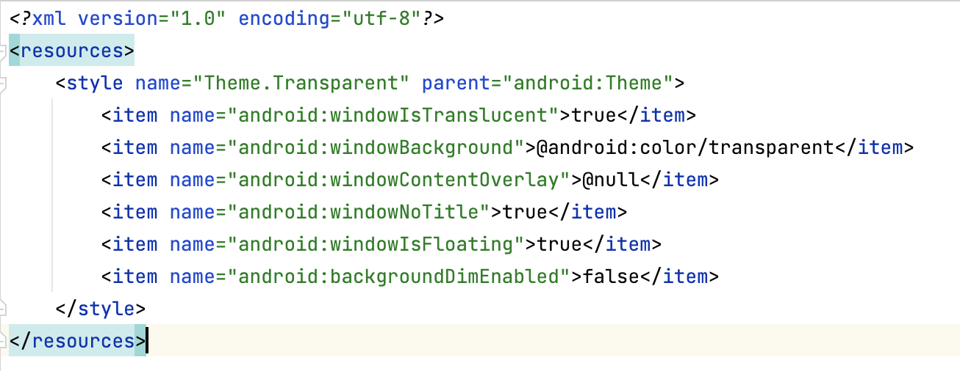

A behavior so far unnoticed

Slide 27


Slide 28
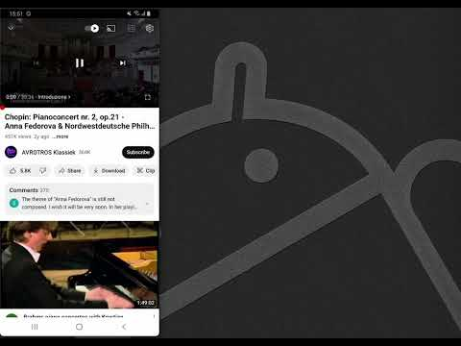

Slide 29

Restrictions
No visibility of the application in the foreground
Background activity start restrictions
No TapJacking

Slide 30

Critical Importance Screens
Request the user to take a critical decision
Screens which belong to 3rd party apps
System screens (permission dialogs, settings etc.)
Single step decision screens (SSDS)
Multi step decision screens (MSDS)

Slide 31
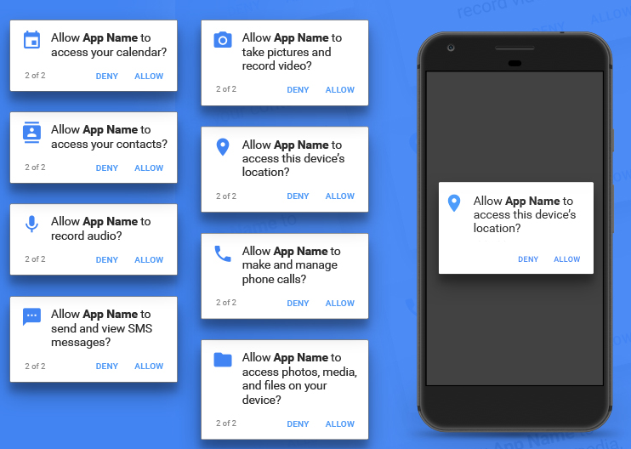
Attacking SSDS
com.google.android.permissioncontroller -> Android 10
com.google.android.permission-> Android 11 (APEX)
(customizable via RROS)

Slide 32
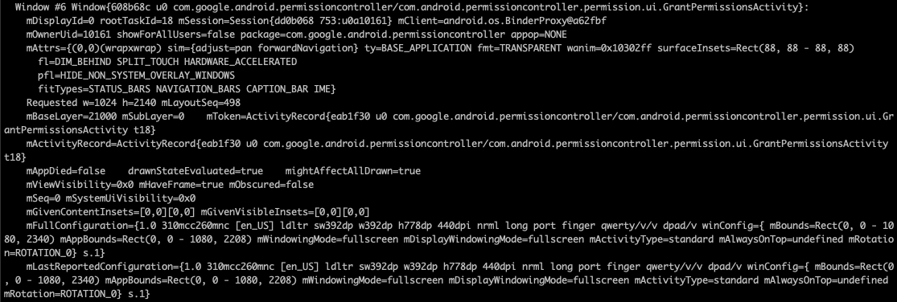
Attacking SSDS
(Android 10)

Slide 33
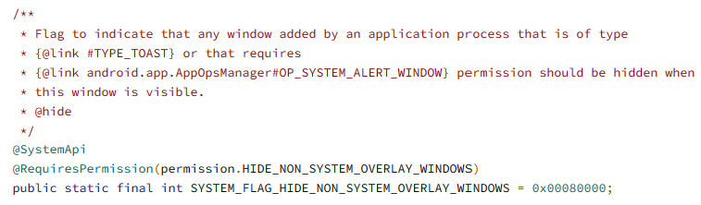
Attacking SSDS
Requires:
HIDE_NON_SYSTEM_OVERLAY_WINDOWS (signature|privileged)
HIDE_OVERLAY_WINDOWS (in Android 12)

Slide 34
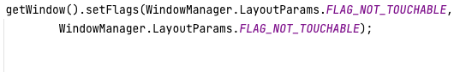
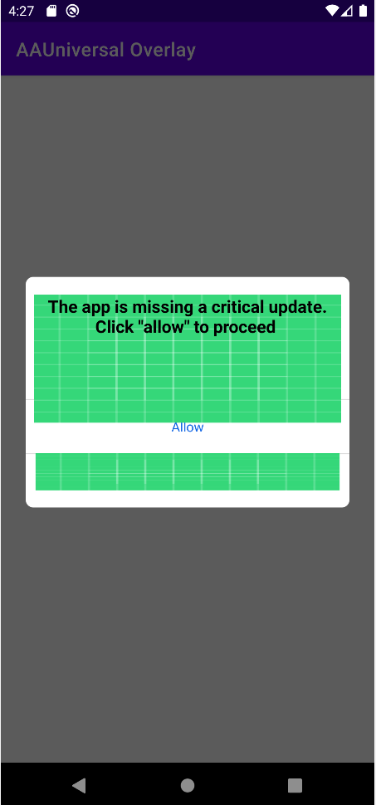
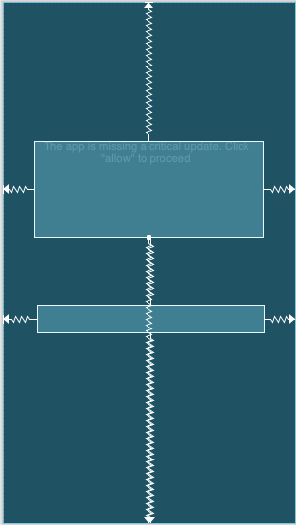
Attacking SSDS
// Click through capability

Slide 35
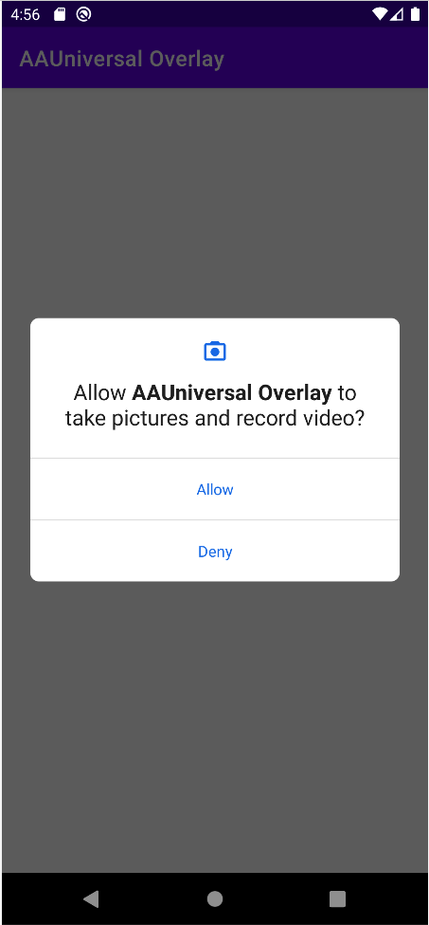
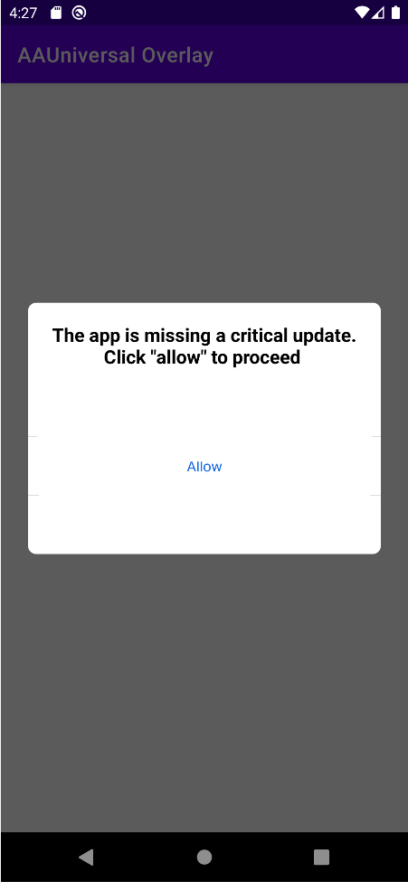
Permission dialog
Permissionless overlay

Slide 36
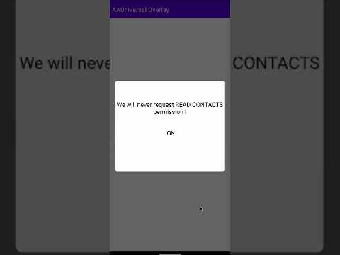

Slide 37
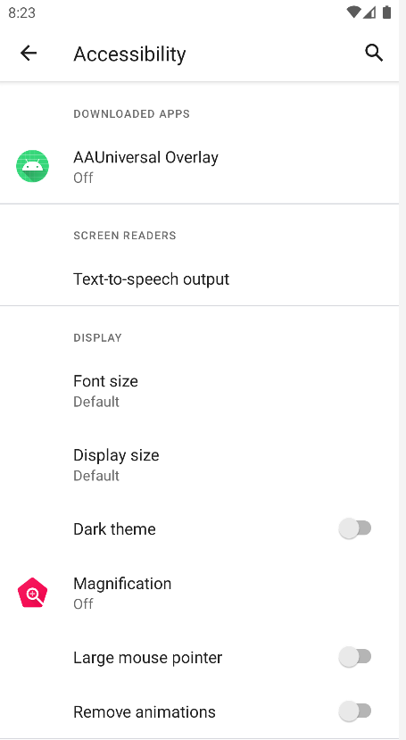
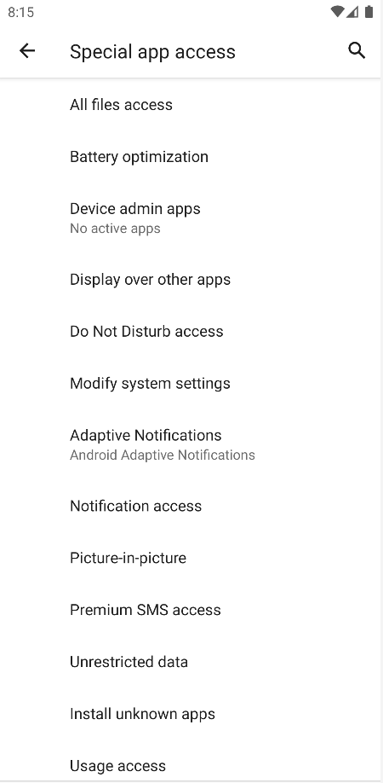
Attacking MSDS

Slide 38
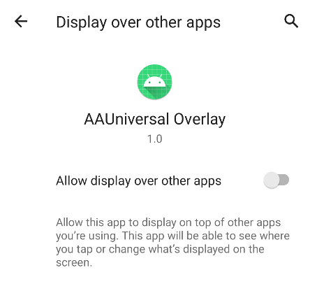
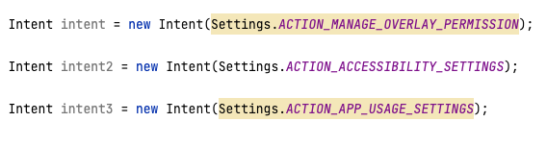
Attacking MSDS

Slide 39
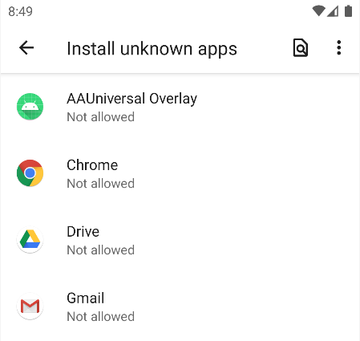

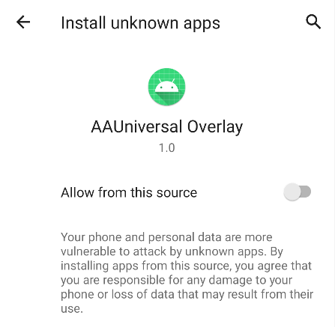


Attacking MSDS
Step 1
Step 2
overlay
overlay
Trampoline activity

Slide 40
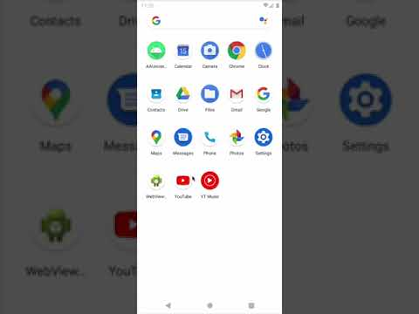

Slide 41
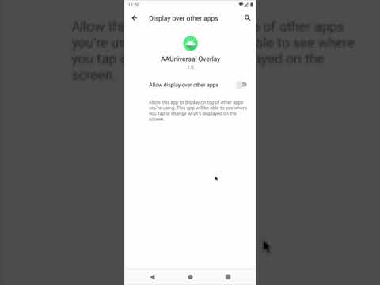
What just
happened

Slide 42


Attacking MSDS (Trampoline Activity)
MainActivity.onCreate
Android Settings App.
ACTION_MANAGE_OVERLAY_PERMISSION​
D.O.T access menu
Trampoline Activity
Trampoline Activity
ACTION_MANAGE_OVERLAY_PERMISSION​
onCreate
D.O.T access menu
Overlay Trampoline
onPause
UI 1
Overlay 1
UI 2
Overlay 2

Slide 43
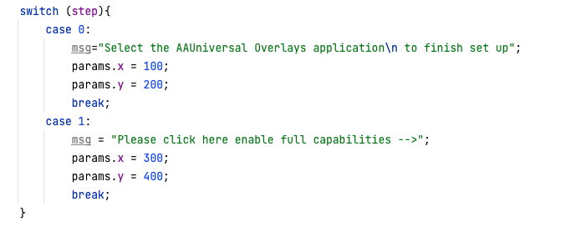
Attacking MSDS (Trampoline Overlay)

Slide 44
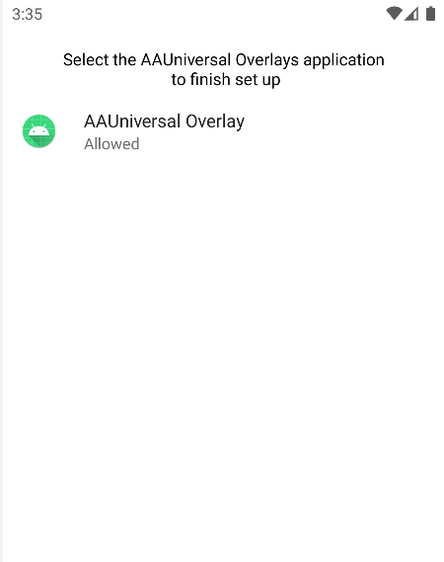
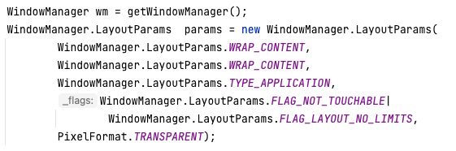
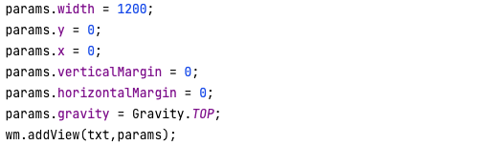

Attacking MSDS (Trampoline Overlay)
Step 1

Slide 45

Attacking MSDS (Trampoline Overlay)
Step 2

Slide 46
Vulnerable screens
Dangerous permissions
All files access
Device Admin
Display over other apps
Modify settings
Install unknown apps
Usage access

Slide 47
Not vulnerable screens
Notification access
Accessibility service

Slide 48
Summary
The users can't identify the application that they are currently interacting with.
When an activity is pushed in the back stack it retains its graphical user interface.
We can integrate the UI of the top activities
Add click-through capability
Hijack SSDS or MSDS for system and 3P apps

Slide 49

Mitigation

Slide 50
Mitigation
HIDE_OVERLAY_WINDOWS (ANDROID 12)
Window.setHideOverlayWindows(boolean hide)

Slide 51





Thank you !
@ch0pin
ch0pin@infosec.echange

